Slide 1
What we are ??
We are Nirbadh Solutions LLP operating two wheeler rental service Under Brand Name Rental wheel in Jaipur with due licensing from State Govt.

Slide 2
Why we are??
Self Driven Bikes are Convenient and Economical way for local Commuting.
Ideal to joy Ride- everybody can ride his/her Dream Bike without investment and no burden of maintenance.
Ideal for short stay in city for any personal or professional purpose.

Slide 3
Why we are??
Best option to explore Tourist Places / Happening Places of city you are visiting.
Increasing trend of use of High-end bikes for events like marriage, Parties and corporate events.
Increasing trend on adventure biking tours like Himachal and Leh-Ladakh Tours, Rajasthan Tour, Himalayan Terrains and other weekend outings.

Slide 4
What we Did !
Without concrete Plan
Start-up may be just Dream
So We had planed our Start-up
We have tested our plan
And results are encouraging to go full scale expansion.
So now we are ready for expansion

Slide 5
Expansion Plan 2019-20 No. of New Branch to be opened = 10
Jaipur-3
Jodhpur
Udaipur
Kota
Ajmer
Bikaner
Alwar
Nimrana

Slide 6
Become a partner in success
We invite you to be the part of Rental Wheel as Promoter.
And get handsome returns on investment.

Slide 7
Investment Plan
Promoter will get the returns on % of Co.’s Revenue Collection not on Profit.
Minimum Investment = 1 Unit
1 Unit = 20,000.00

Slide 8
Promoter’s Share ??
On every investment of 20000.00 (1Unit) Promoter will get % (as per slab) of total revenue collected during F.Y.
Revenue collection slab | Return to Promoter Per UNIT
1-1,00,00,00 | 0.04%
1,0000001 to 2 cr | 0.03%
20000001 to 3 cr | 0.02%
30000001 to 5 cr | 0.01%
50000001 to 10cr | 0.005%
Above 10 cr | 0.002%

Slide 9
Promoter’s Share ??
E.g. In case Total revenue Collection of FY 2019-20 is 1.00cr., Promoter will get 0.04% of 1.00cr. I.e. 4000.00 (20% ROI)
E.g. In case Total revenue Collection of FY 2019-20 is 1.60cr., Promoter will get 0.04% of 1.00 cr. (10000000 x 0.04% = 4000) and 0.03% of remaining 60Lac (60,000,00x 0.03% = 1800) I.e 5800.00 ( 29% ROI)

Slide 10
Projected Revenue & ROI
Projected Revenue Collection | Per Unit Return to Promoter | ROI %
5000000 | 2000 | 10.00% (MG)
10000000 | 4000 | 20.00%
20000000 | 7000 | 35.00%
30000000 | 9000 | 45.00%
40000000 | 10000 | 50.00%
50000000 | 11000 | 55.00%
100000000 | 13500 | 67.50%

Slide 11
Goal for next 2 Years!
To be at leadership position in Bike rental services.
By 2020-21 Turnover of 10 Cr.

Slide 12
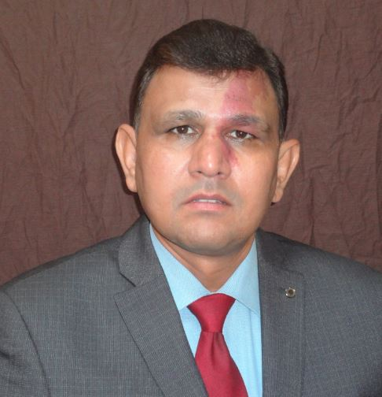
To know more please contact
Ravi Kant Sharma, 99 50 45 45 45
Or visit www.rentalwheel.in

