Slide 1
What we are ??
We are Nirbadh Solutions LLP operating two wheeler rental service Under Brand Name Rental wheel in Jaipur with due licensing from State Govt.

Slide 2
Why we are??
Self Driven Bikes are Convenient and Economical way for local Commuting.
Ideal to joy Ride- everybody can ride his/her Dream Bike without investment and no burden of maintenance.
Ideal for short stay in city for any personal or professional purpose.

Slide 3
Why we are??
Best option to explore Tourist Places / Happening Places of city you are visiting.
Increasing trend of use of High-end bikes for events like marriage, Parties and corporate events.
Increasing trend on adventure biking tours like Himachal and Leh-Ladakh Tours, Rajasthan Tour, Himalayan Terrains and other weekend outings.

Slide 4
Bikes in Demand
Harley Davidson
Royal Enfield
Bajaj Avenger/ Pulsar
Scooters-Activa/Maestro/Jupiter

Slide 5
What we Did !
Without concrete Plan -Start-up may be just Dream
So We had planed our Start-up
We have tested our plan
And results are encouraging to go full scale expansion.
So now we are ready for expansion

Slide 6
Expansion Plan 2019-20 No. of New Branch to be opened = 30
Sitapura -2
Jagatpura - 2
PratapNagar -2
Malviya Nagar -2
Mansarover - 2
Tonk Fatak -1
Gurjar ki Thadi -1
Raja Park -2
Nr. Hawamahal -1
Ramgarh Mod -1
Nr. Jal Mahal -1
Kukas -1
Amber- 1
Chomu Poulia -1
VKI 14 No. -1
Vaishali Nagar-1
Chitrakoot -1
Shyam Nagar- 1
Khati Pura-1
Jhotwara -2
Vidhya dhar Nagar-2
Shastri Nagar-1

Slide 7
Become a partner in success
We invite you to be the part of Rental Wheel as Pickup point.
And get handsome returns on investment.

Slide 8
Investment Plan
Pickup Point will get the returns on % of Revenue Collection not on Profit.
Minimum Investment = 3 Bike/ scooter

Slide 9
Pickup Point’s Share ??
On every Booking Pickup Point Holder will get 75% of Billing amount
E.g. In case Total Bill of One Activa is Rs. 400.00 for one Day, Pickup Point Holder will get Rs. 300.00.

Slide 10
Projected Revenue & ROI
No Of Scooter/ Bike | Total Investment @ 75000/ Bike | Rent / Day | Collection = 3*400 | Projected Booking Per Month @ 60% =30*60% | Total collection per Month | Monthly ROI % | Yearly ROI %
3 | 225000 | 400 | 1200 | 18 | 21600 | 9.60% | 115%

Slide 11
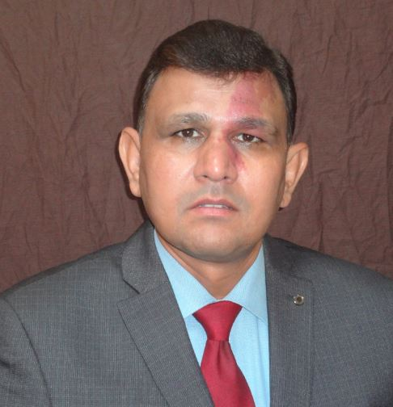
To know more please contact
Ravi Kant Sharma, 99 50 45 45 45
Or visit www.rentalwheel.in

